Slide 1
Bootstrap Model
廖向德

Slide 2
The Modal Plugin
The Modal plugin is a dialog box/popup window that is displayed on top of the current page
Tip: Plugins can be included individually (using Bootstrap's individual "modal.js" file), or all at once (using "bootstrap.js" or "bootstrap.min.js").
Example

Slide 3
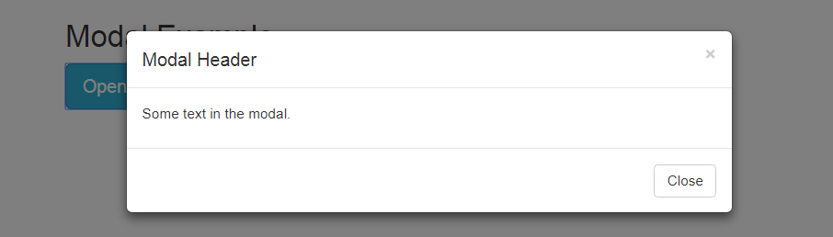
Create a Modal
Example
Notes:
<!DOCTYPE html>
<html lang="en">
<head>
<title>Bootstrap Example</title>
<meta charset="utf-8">
<meta name="viewport" content="width=device-width, initial-scale=1">
<link rel="stylesheet" href="https://maxcdn.bootstrapcdn.com/bootstrap/3.3.7/css/bootstrap.min.css">
<script src="https://ajax.googleapis.com/ajax/libs/jquery/3.2.1/jquery.min.js"></script>
<script src="https://maxcdn.bootstrapcdn.com/bootstrap/3.3.7/js/bootstrap.min.js"></script>
</head>
<body>
<div class="container">
<h2>Modal Example</h2>
<!-- Trigger the modal with a button -->
<button type="button" class="btn btn-info btn-lg" data-toggle="modal" data-target="#myModal">Open Modal</button>
<!-- Modal -->
<div class="modal fade" id="myModal" role="dialog">
<div class="modal-dialog">
<!-- Modal content-->
<div class="modal-content">
<div class="modal-header">
<button type="button" class="close" data-dismiss="modal">&times;</button>
<h4 class="modal-title">Modal Header</h4>
</div>
<div class="modal-body">
<p>Some text in the modal.</p>
</div>
<div class="modal-footer">
<button type="button" class="btn btn-default" data-dismiss="modal">Close</button>
</div>
</div>
</div>
</div>
</div>
</body>
</html>

Slide 4
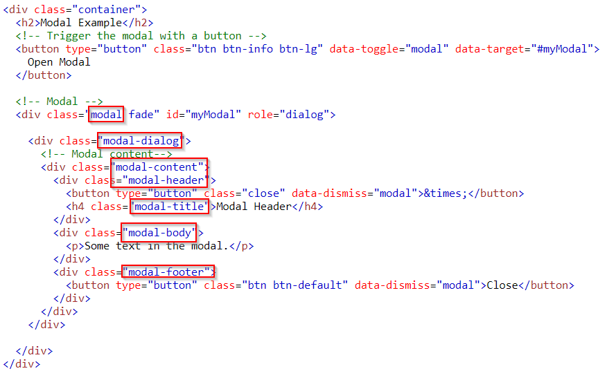
Create a Modal (1/4)
Notes:
<!DOCTYPE html>
<html lang="en">
<head>
<title>Bootstrap Example</title>
<meta charset="utf-8">
<meta name="viewport" content="width=device-width, initial-scale=1">
<link rel="stylesheet" href="https://maxcdn.bootstrapcdn.com/bootstrap/3.3.7/css/bootstrap.min.css">
<script src="https://ajax.googleapis.com/ajax/libs/jquery/3.2.1/jquery.min.js"></script>
<script src="https://maxcdn.bootstrapcdn.com/bootstrap/3.3.7/js/bootstrap.min.js"></script>
</head>
<body>
<div class="container">
<h2>Modal Example</h2>
<!-- Trigger the modal with a button -->
<button type="button" class="btn btn-info btn-lg" data-toggle="modal" data-target="#myModal">
Open Modal
</button>
<!-- Modal -->
<div class="modal fade" id="myModal" role="dialog">
<div class="modal-dialog">
<!-- Modal content-->
<div class="modal-content">
<div class="modal-header">
<button type="button" class="close" data-dismiss="modal">&times;</button>
<h4 class="modal-title">Modal Header</h4>
</div>
<div class="modal-body">
<p>Some text in the modal.</p>
</div>
<div class="modal-footer">
<button type="button" class="btn btn-default" data-dismiss="modal">Close</button>
</div>
</div>
</div>
</div>
</div>
</body>
</html>

Slide 5
Create a Modal (2/4) The "Trigger" part
To trigger the modal window, you need to use a button or a link.
data-toggle="modal" opens the modal window
data-target="#myModal" points to the id of the modal

Slide 6
Create a Modal (3/4) The "Modal" part
The parent <div> of the modal must have an ID that is the same as the value of the data-target attribute used to trigger the modal ("myModal").
The .modal class identifies the content of <div> as a modal and brings focus to it.
The .fade class adds a transition effect which fades the modal in and out. Remove this class if you do not want this effect.
The attribute role="dialog" improves accessibility for people using screen readers.
The .modal-dialog class sets the proper width and margin of the modal.

Slide 7
Create a Modal (4/4) The "Modal content" part
The <div> with class="modal-content" styles the modal (border, background-color, etc.). Inside this <div>, add the modal's header, body, and footer.
The .modal-header class is used to define the style for the header of the modal.
The <button> inside the header has a data-dismiss="modal“ attribute which closes the modal if you click on it. The .close class styles the close button
The .modal-title class styles the header with a proper line-height.
The .modal-body class is used to define the style for the body of the modal.
Add any HTML markup here; paragraphs, images, videos, etc.
The .modal-footer class is used to define the style for the footer of the modal.
Note that this area is right aligned by default.

Slide 8


Modal Size
Change the size of the modal by adding the .modal-sm class for small modals or .modal-lg class for large modals
Add the size class to the <div> element with class .modal-dialog
Example(small)
Example (large)
By default, modals are medium in size.

Slide 9
Practice
Try to create a Modal
Try to change Modal size
Try to remove some element or class to see what happen

